Slide 1


CSE 446 / 598 Software Integration and Engineering
Unit 2 Software Development by Composition and Integration
Unit 2-3 Workflow Composition
and Case Studies
Dr. Yinong Chen

Slide 2
Outline of the Lecture
Creating a Workflow Console Application
Adding a Flowchart Component into a Workflow
Adding Other Components into a Workflow
Adding a CodeActivity into a Workflow
Adding an External Web Service into a Workflow
Creating Workflow Services
Contract-First Approach, resulting a service.svc file
Workflow-First Approach, resulting a service.xamlx file
Case Studies:
Image Verifier in Workflow
Mortgage Application Integration

Slide 3
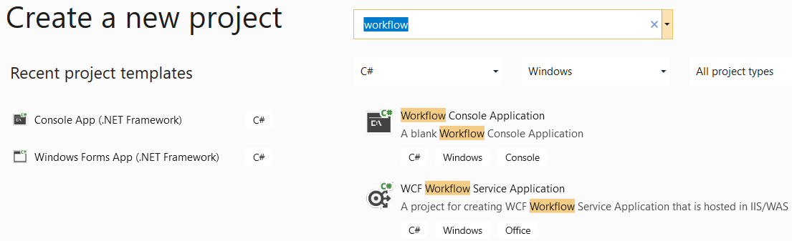
Creating a Workflow Console Application
In Visual Studio 2019
Creating Workflow Application
Creating Workflow Web Service

Slide 4
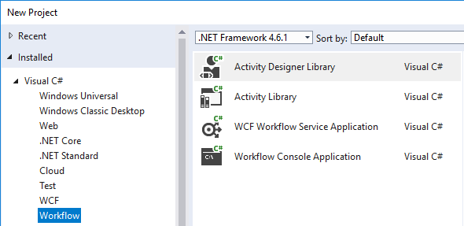
Creating a Workflow Console Application
In Visual Studio 2017, Start a New Project

Slide 5
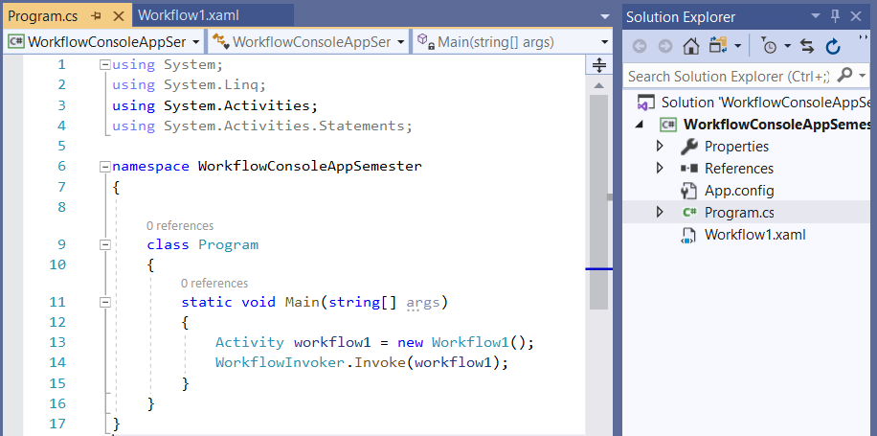
Workflow Console Application
In Workflow Console Application template,
The Main() method in Program.cs is the entry point
The workflowInvoker invokes the Workflow1.xaml file
The workflow is considered a thread and started by the Main method.

Slide 6
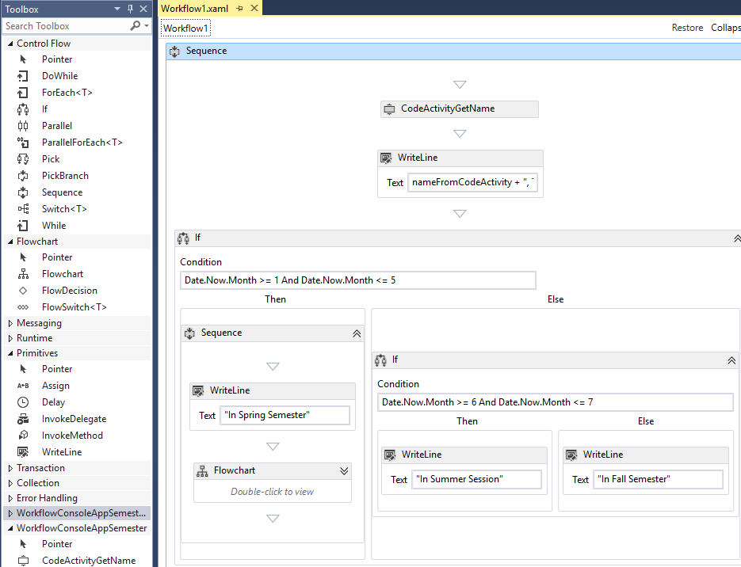
Graphic Development of Workflow.xaml
1
2
4
3
5
6
7

Slide 7
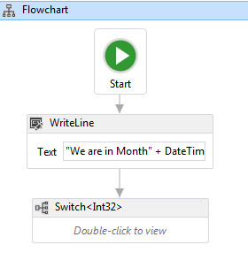
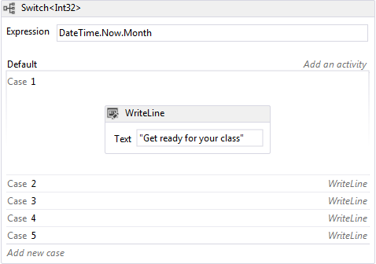

A Flowchart is an Instant Component
A Flowchart creates an instant component in a workflow! The custom component does not appear in toolbox
A Switch is a construct only. It has a fixed structure.

Slide 8
Outline of the Lecture
Creating a Workflow Console Application
Adding a Flowchart component into a Workflow
Adding Other Components into a Workflow
Adding a CodeActivity into a Workflow
Adding an External Web Service into a Workflow
Creating Workflow Services
Contract-First Approach, resulting a service.svc file
Workflow-First Approach , resulting a service.xamlx file
Case Studies:
Image Verifier in Workflow
Mortgage Application Integration

Slide 9
Custom Code Activities
Using pre-built components to compose applications are convenient and fast;
We often cannot find the components we need: We need the capacity of building our own components.
A Flowchart creates an instant component in the workflow. It creates a module, but it is not reusable.
Furthermore, a flowchart is mainly for composition. It does not do basic computing well.
We need the capacity of adding code (e.g., C#) activity: CodeActivity.
WF makes this capacity easy.

Slide 10
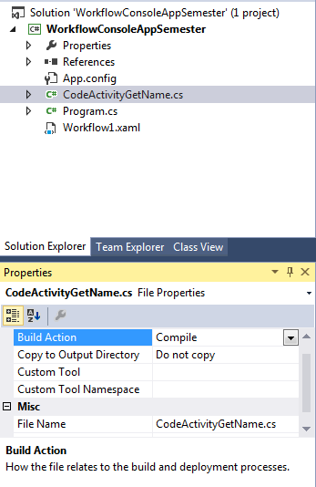
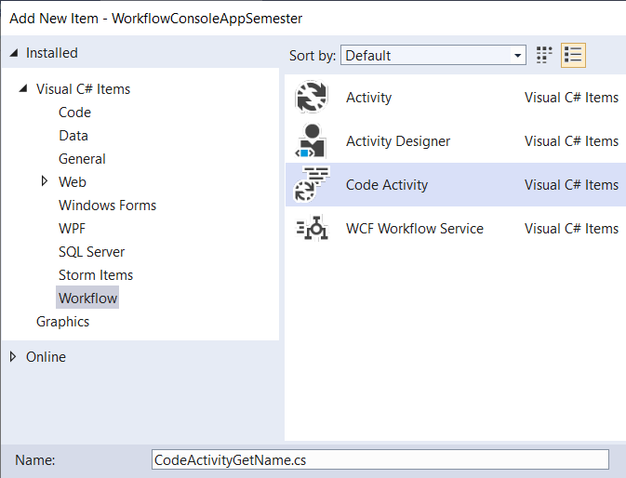
Adding a CodeActivity into Workflow
Type C# code in this file
From VS we use Add New Item, and then it goes into the toolbox.

Slide 11
Template Code in the Code Activity
namespace WorkflowConsoleAppSemester {
public sealed class CodeActivityGetName : CodeActivity {
// Define an activity input argument of type string
public InArgument<string> defaultName { get; set; }
// Define an activity output argument of type string
public OutArgument<string> enteredName { get; set; }
// If your activity returns a value, derive from CodeActivity<TResult>
// and return the value from the Execute method.
protected override void Execute(CodeActivityContext context) {
// Obtain the runtime value of the Text input argument
Console.WriteLine("Please enter your name");
string yourName = Console.ReadLine();
if (yourName == "") {
string dName = context.GetValue(this.defaultName);
yourName = dName; }
string helloName = " Hello " + yourName;
context.SetValue(this.enteredName, helloName);
} } }
input
output
Custom code

Slide 12
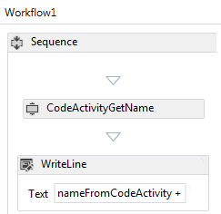
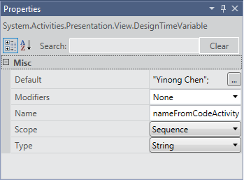
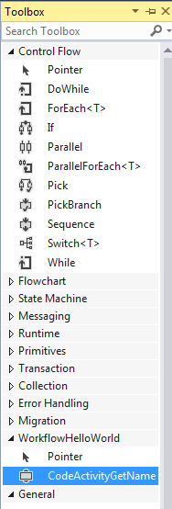
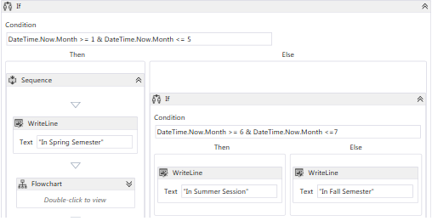
Adding CodeActivity into Workflow
Build your solution. Then, the activity will occur in the toolbox
Added code activity is reusable
Set value to activity arguments
Variable created

Slide 13
Template for CodeActivity
input
public InArgument<string> defaultName
{ get; set; } // which takes input from the workflow. In this // example, we could pass a string “John Doe” to the // code activity.
public OutArgument<string> enteredName
{ get; set; } // which returns a value to the calling workflow.
protected override void Execute(CodeActivityContext context) { // we add C# code that we want to execute here. }
output
Custom code

Slide 14
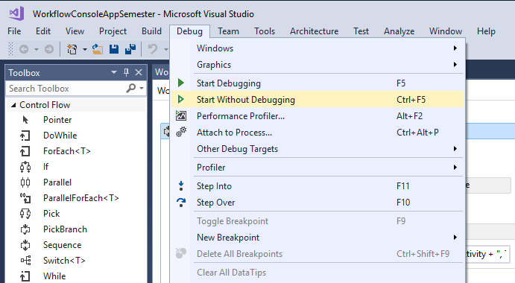
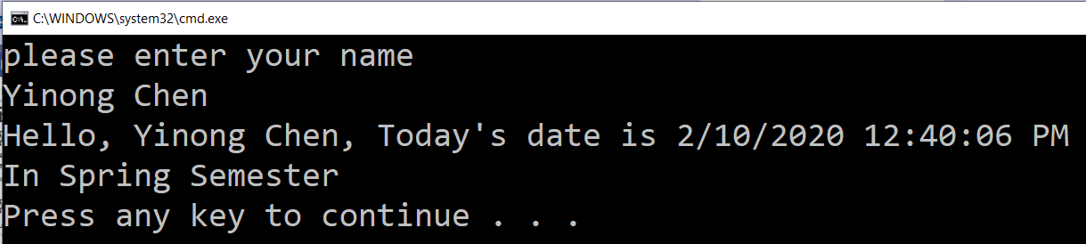
Test the Code

Slide 15
Outline of the Lecture
Creating a Workflow Console Application
Adding a Flowchart component into a Workflow
Adding Other Components into a Workflow
Adding a CodeActivity into a Workflow
Adding an External Web Service into a Workflow
Creating Workflow Services
Contract-First Approach, resulting a service.svc file
Workflow-First Approach , resulting a service.xamlx file
Case Studies:
Image Verifier in Workflow
Mortgage Application Integration

Slide 16
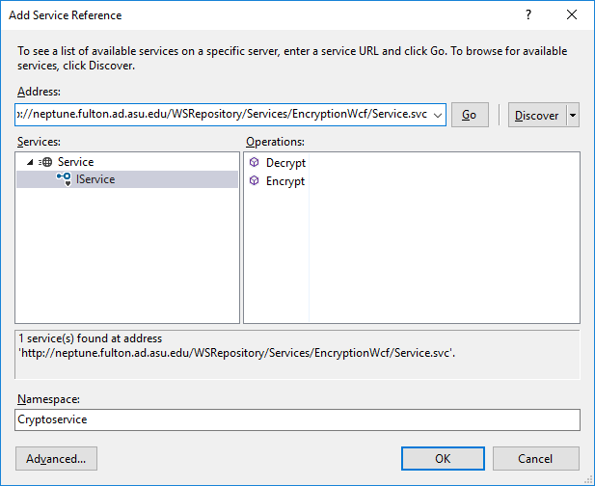
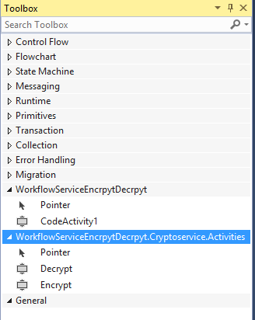
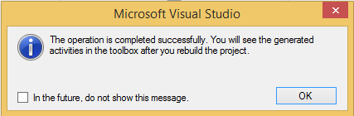
Add and Call a Remote Web Service
http://neptune.fulton.ad.asu.edu/WSRepository/Services/EncryptionWcf/Service.svc

Slide 17
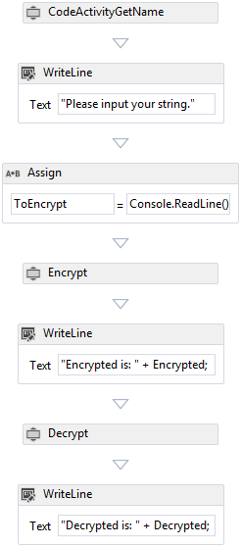
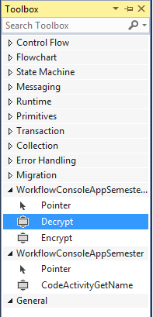
Add Services
You can use a remote Web service just like a local code activity, by dragging and dropping!

Slide 18
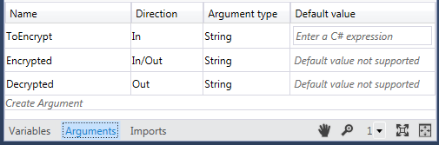
Defining Arguments for Services

Slide 19
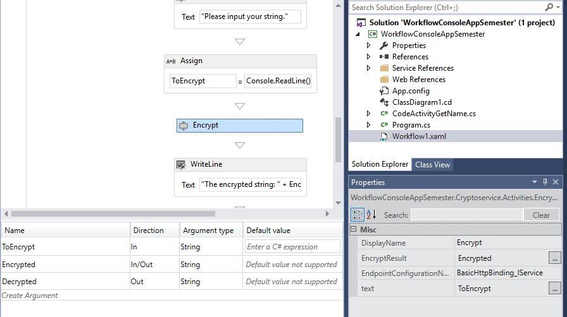
Associate the Arguments to the Service
1. Right click to open Properties
2
3
4

Slide 20
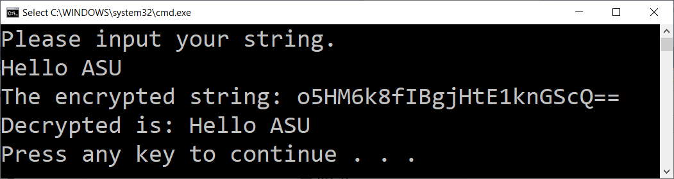
Test the Code
The input number is encrypted and the decrypted
How do we call a RESTful service?
Using CodeActivity

Slide 21
Outline of the Lecture
Creating a Workflow Console Application
Adding a Flowchart component into a Workflow
Adding Other Components into a Workflow
Adding a CodeActivity into a Workflow
Adding an External Web Service into a Workflow
Creating Workflow-based Web Services
Contract-First Approach, resulting a service.svc file
Workflow-First Approach , resulting a service.xamlx file
Case Studies:
Image Verifier in Workflow
Mortgage Application Integration

Slide 22
Workflow Applications and Services
Workflow supports architecture-driven approach of software development. It can be used for developing applications as well as services.
WF is designed for working with WCF to
Consume WCF services, as we just discussed
Implement WCF services
There are two approaches in applying workflow in a WCF service:
Contract-first
Workflow-first.

Slide 23
Two Approaches of Workflow Services
Contract-First Service Development:
Use the “WCF Service Application” template to start an ordinary WCF service project.
The service will be exposed as a .svc service
Add a workflow activity in the project to perform the high-level code organization work.
Create a synchronous service
Workflow-First Service Development:
Use a specifically designed template: “WCF Workflow Service Application” to create a new type of WCF service, with extension .xamlx
The service interfaces are created in workflow development.
Create a synchronous service or an asynchronous service

Slide 24
Contract-First Service Development
Start a new project and choose the WCF template “WCF Service Application”;
Right-click project file and choose “Add” and then “New Item…”;
Choose the Workflow template and then choose the “Activity” item; Name the item “myServiceActivity.xaml”;
Follow the same steps to define IService.cs interface file;
In your Service.svc.cs file, you add the directive: using System.Activities; and then, you can simply call the activity in the service operation: WorkflowInvoker.Invoke(new myServiceActivity());

Slide 25
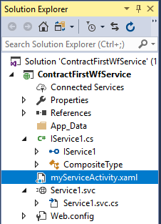
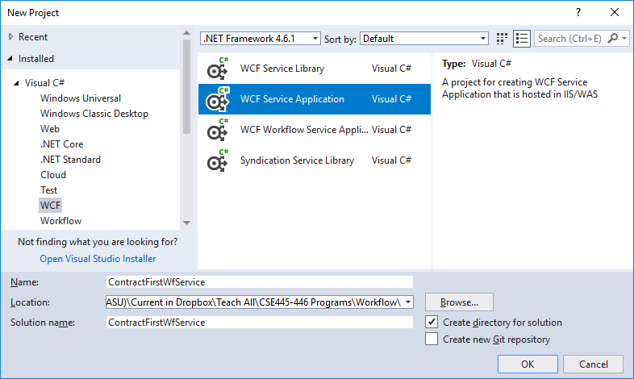
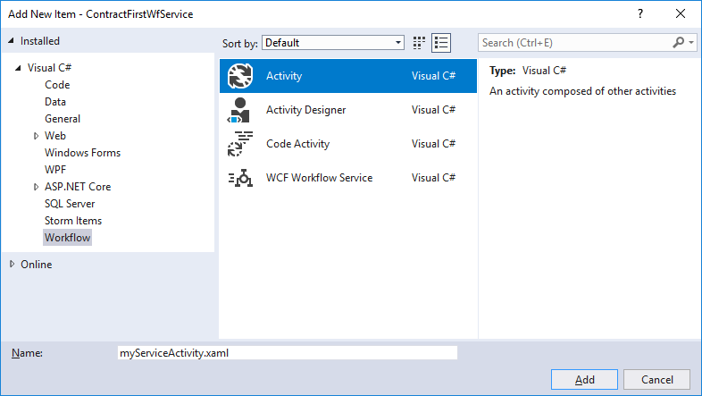
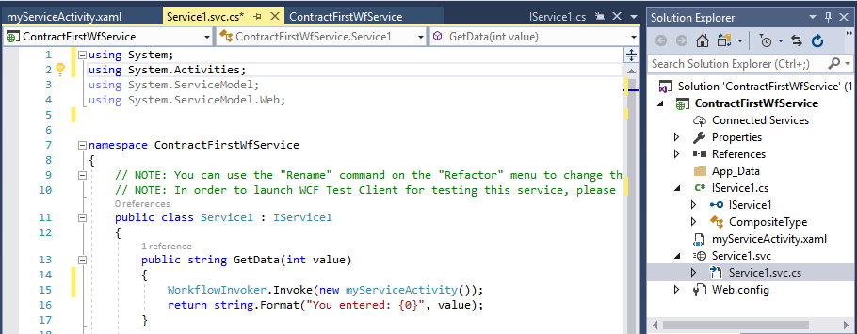
Contract-First Service Development
You can convert it into a RESTful service by following the steps we discussed.
Finally, we can follow the previous example to write the workflow code for “myServiceActivity.xaml”

Slide 26
Two Approaches of Workflow Services
Contract-First Service Development:
Use the “WCF Service Application” template to start an ordinary WCF service project.
The service will be exposed as a .svc service
Add a workflow activity in the project to perform the high-level code organization work.
Create a synchronous service
Workflow-First Service Development:
Use a specifically designed template: “WCF Workflow Service Application” to create a new type of WCF service, with extension .xamlx
The service interfaces are created in workflow development.
Create a synchronous service or an asynchronous service

Slide 27
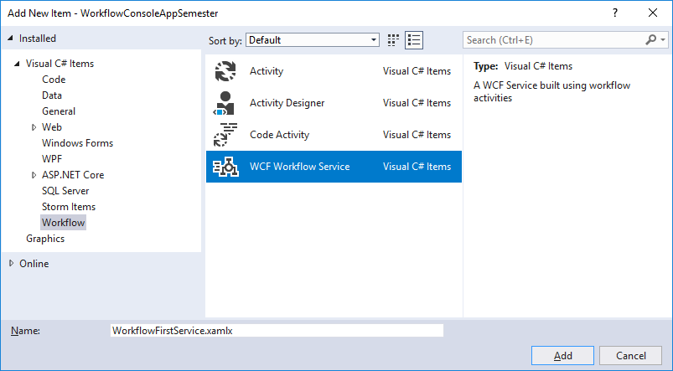
Workflow-First Service Development
Start a new project, select Workflow template, and select the “WCF Workflow Service Application”.

Slide 28
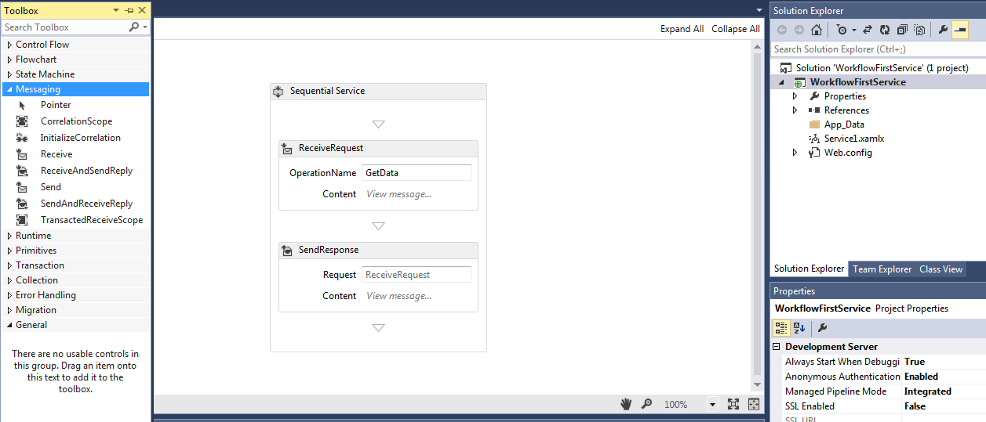
Workflow-First Template
These activities can be used for synchronous and asynchronous communications
These activities can be used for synchronous and asynchronous communications
Use Receive activity to listen to the service call;
To build different types of interfaces
Use Send activity to send data back to client;

Slide 29
Roadmap of the Lecture
Creating a Workflow Console Application
Adding Other Components into a Workflow
Creating Workflow Services
Case Studies of Persistence Service:
Image Verifier in Workflow
Text Section 7.4.5 with full detail
Service in ASU Service Repository
Mortgage Application Integration
Using Workflow-First approach
Code downloadable at: http://msdn.microsoft.com/en-us/magazine/ff646977.aspx

Slide 30
What is a Persistence Service?
A persistence service requires more than one access.
It is similar to asynchronous service, where two calls are required, but it is different in the ways that a persistence service
may allow the second call to come after a long time, and thus it must save the partially finished service in a data store;
requires a correlation ID to relate all the calls to each other;
can accept independent inputs from all the calls.
Use Image Verifier as an Example.

Slide 31
Creating a Persistence Service With Correlation
The client of an Image Verifier service must use two invocations to the service:
send string length,
send user-entered string
Sequence
State
ReceiveRequest (Length, UserId)
Serve the request: Generate a random image
First request
correlation
Service Interface
Client
Return an image
Second request
Receive (inVeriferString, UserID)
Serve the request: Verify the string
These two invocations must be correlated by the service.
Return message
WF Runtime

Slide 32
Workflow of Image Verifier Service as a Finite State Machine, with a variable “completed”
A
ReceiveRequest(myLength, userID)
OpeartionName: GetImage;
Initialization: completed = true;
B
C
ep1
Invoke GetVerifierString(myLeng); // call a web service
SendResponse a random string;
Invoke GetImage(myString); // call a web service
Send image to client; State: completed = false;
Parallel
A
ReceiveRequest( )
OperationName: Reboot;
State: completed = true;
Receive(inVerifierString, userID)
OperationName: CheckResult;
Myresult=(inVerifierString==VerifierString)
A
B
B
C
C
ep3
ep2
In case the user does not call back

Slide 33
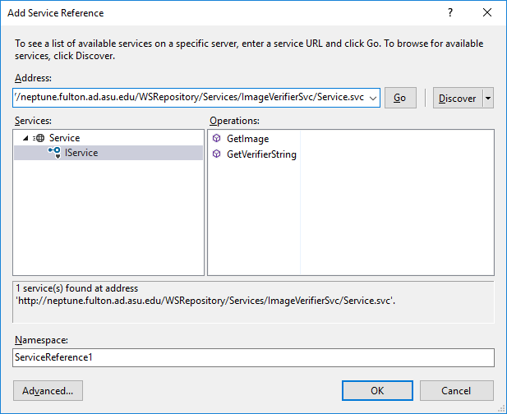
Converting SVC Image Service to Persistence Service
This services has two independent synchronous endpoints
We will create a new persistence service with three correlated endpoints.

Slide 34
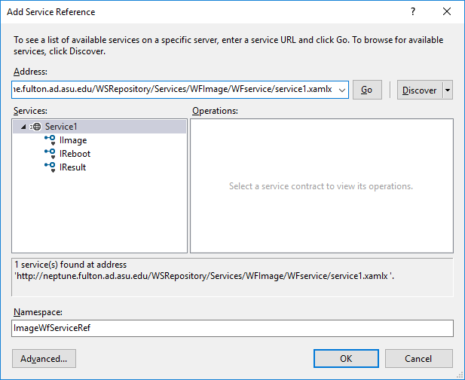
A New Two-Call Service that you can Add to other applications
Endpoint 1: Start a new request
Endpoint 3: Reset the service in case the previous caller does not make the second call. Hide this from normal users.
Endpoint 2: Compare the user-entered string with the generated string.

Slide 35
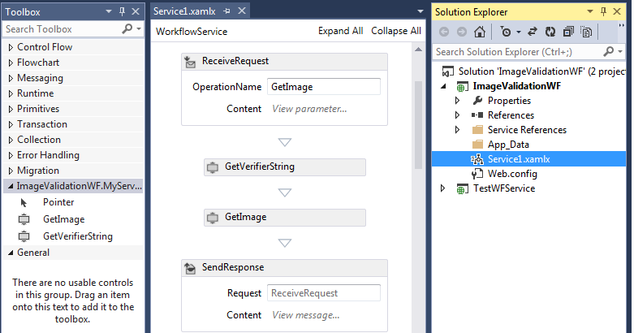
Workflow of Image Verifier Service After .svc image service is added
Receive string length and UserID
Send image to client
Waiting for client entered string

Slide 36
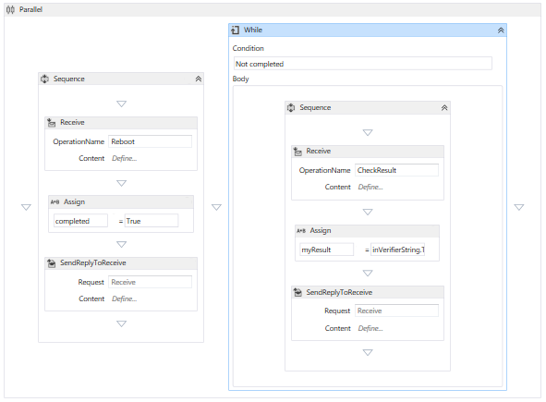
The Main Part of the Workflow
Client sends back a string
Why do we need this endpoint?
My server does not support persistence calls. Call it to terminate the previous half call, assuming it never makes the 2nd call.

Slide 37
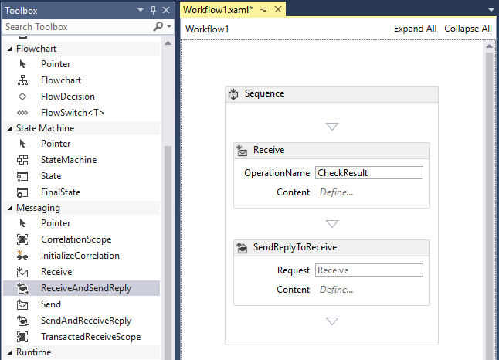
ReceiveAndSendReply Composite Activity
It consists of Sequence, Receive and SendReplyToReceive

Slide 38
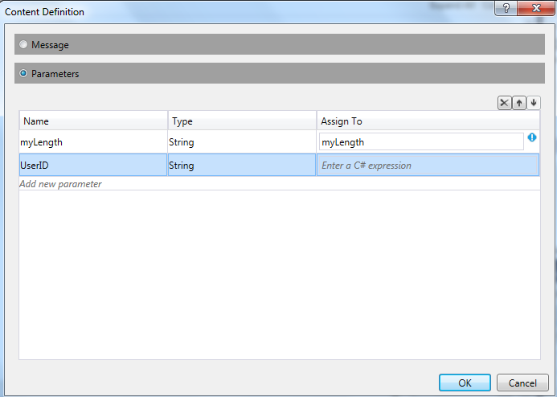
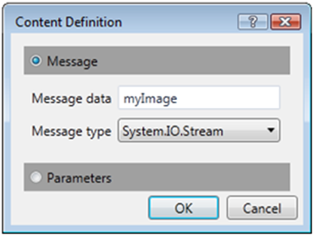
“View parameter…” and “View message…”

Slide 39
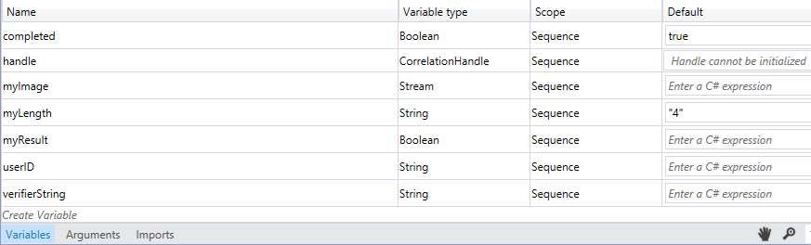
Variables Defined for the Workflow
Two calls must be associated through a handle
used by all three receive activities as a parameter for identifying the correlation among all visits from the same user.

Slide 40
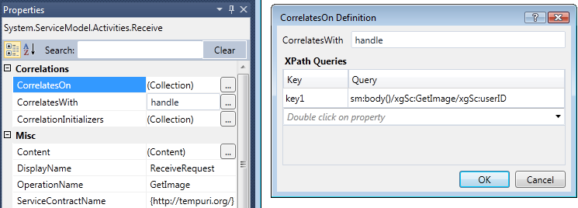
Definition of Correlation Variable Handle
http://neptune.fulton.ad.asu.edu/WSRepository/Services/WFImage/WFservice/service1.xamlx http://neptune.fulton.ad.asu.edu/WSRepository/Services/WFImage/WFService/Service1.xamlx?wsdl
More detail is in text section 7.4.5

Slide 41
Roadmap of the Lecture
Creating a Workflow Console Application
Adding Other Components into a Workflow
Creating Workflow Services
Case Studies of Persistence Service:
Image Verifier in Workflow
Text Section 7.4 with full detail
Service in ASU Service Repository
Mortgage Application Integration
Using Workflow-First approach
Code downloadable at: http://msdn.microsoft.com/en-us/magazine/ff646977.aspx

Slide 42
Application Requirement (Scenarios)
Contoso Housing is a real estate company that sells houses.
To provide better customer service and an end-to-end buying experience, Contoso partners with three mortgage companies that assist potential customers with their mortgage needs.
Each mortgage company offers different interest rates.
Contoso prioritizes mortgage vendors by their interest rates to ensure that customers get the best deal (using the assumption that a better rate makes the house more likely to sell)

Slide 43
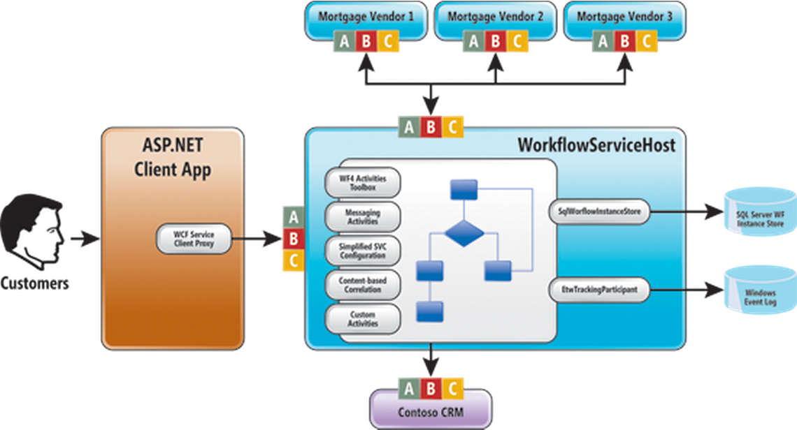
Overview of the Application and Service
Source: http://msdn.microsoft.com/en-us/magazine/ff646977.aspx
What are the ABCs ?
What are the ABCs ?

Slide 44
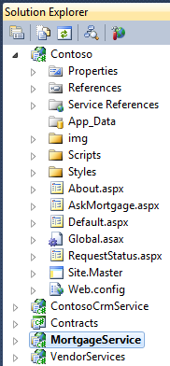
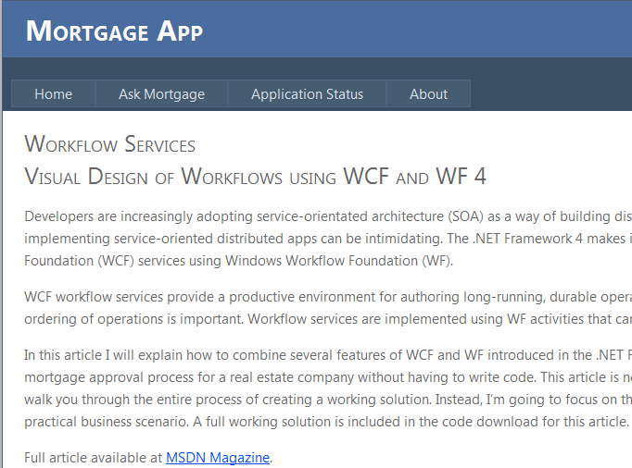
Case Study: Mortgage Application (Client)
Source: http://msdn.microsoft.com/en-us/magazine/ff646977.aspx

Slide 45
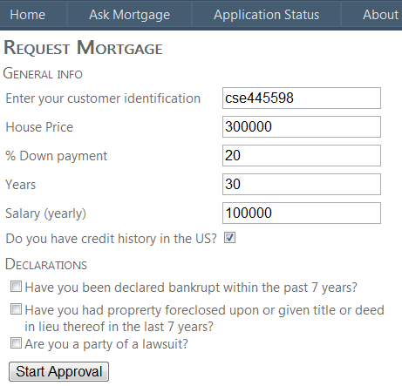
Case Study: Mortgage Application (Client)
You can combine the image verifier here.
Where do I get the ID?

Slide 46
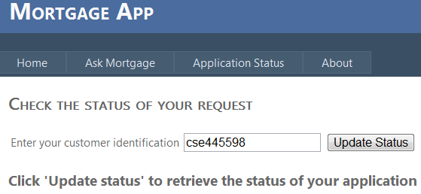
Case Study: Mortgage Application (Client)
What is a persistence service?

Slide 47
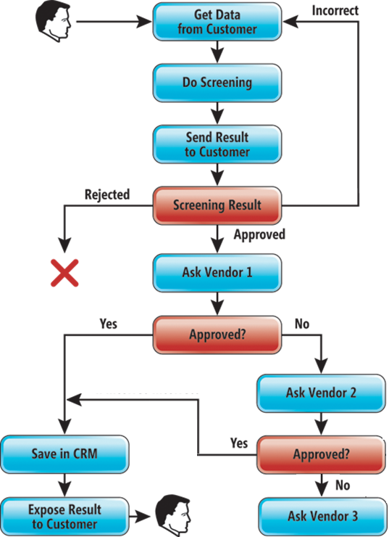
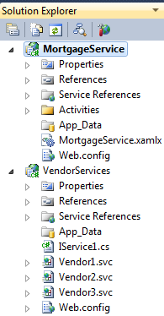
Workflow Service
Conceptual Diagram

Slide 48
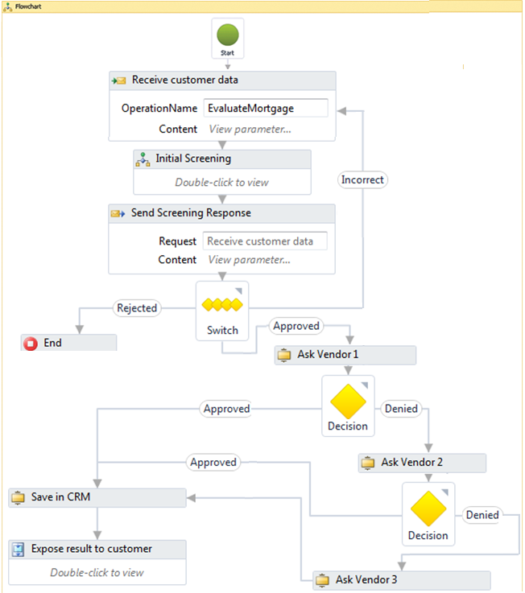
The Mortgage Approval Process as a Flowchart
Workflow Diagram

Slide 49
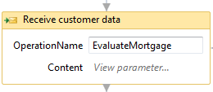
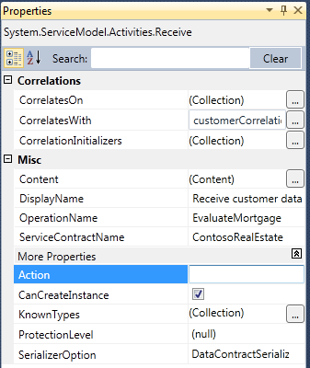
Define the Properties of Receive Activity
Define the WCF Endpoint: Operation Contract: Parameters in & out
Define the WCF Endpoint: Operation Contract: Operation Name

Slide 50
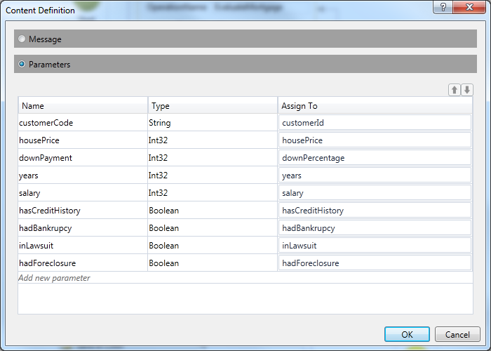
Configuring Input Parameters

Slide 51

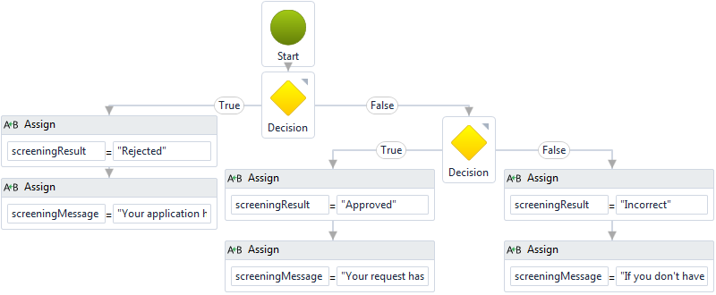
Adding the “Initial Screening” Flowchart

Slide 52
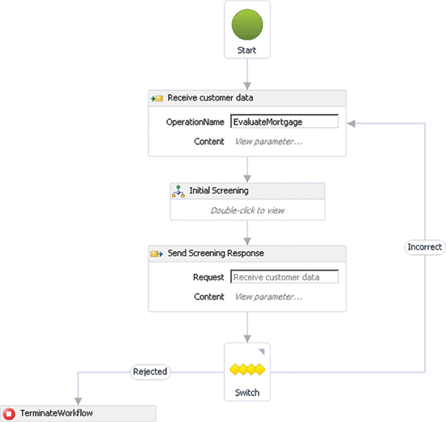
Each Outbound Arrow in the Switch Represents a Case in the Switch

Slide 53


Ask Vendor CodeActivity

Slide 54

Service Deployed at
http://neptune.fulton.ad.asu.edu/WSRepository/Services/WFService/MortgageService/Service1.xamlx
Note that a workflow service generates a WSDL interface!

Slide 55
Testing the Mortgage Example
The code can be downloaded at http://msdn.microsoft.com/en-us/magazine/ff646977.aspx
The code is deployed at: The client application (TryIt Page): neptune.fulton.ad.asu.edu/WSRepository/Services/WFService/ Services: neptune.fulton.ad.asu.edu/WSRepository/Services/WFService/MortgageService/Service1.xamlx neptune.fulton.ad.asu.edu/WSRepository/Services/WFService/VendorService/Vendor1.svc neptune.fulton.ad.asu.edu/WSRepository/Services/WFService/VendorService/Vendor2.svc neptune.fulton.ad.asu.edu/WSRepository/Services/WFService/VendorService/Vendor3.svc
Only the basic functions, including the ASP .Net Client App, the workflow-based mortgage service, and the three vendor services are deployed. The CRM and the database services are deployed.

Slide 56
Summary of the Lecture
Workflow applications and services can take different components
Flowchart component into a Workflow
Custom activities (CodeActivity) in C# and VB
External Web Service
Creating Workflow Services
Contract-First Approach, resulting a service.svc file
Workflow-First Approach, resulting a service.xamlx file
Workflow Case Studies with asynchronous service with two correlated invocations
Image Verifier in Workflow, persistence service
Mortgage Application Integration

